Slide 1
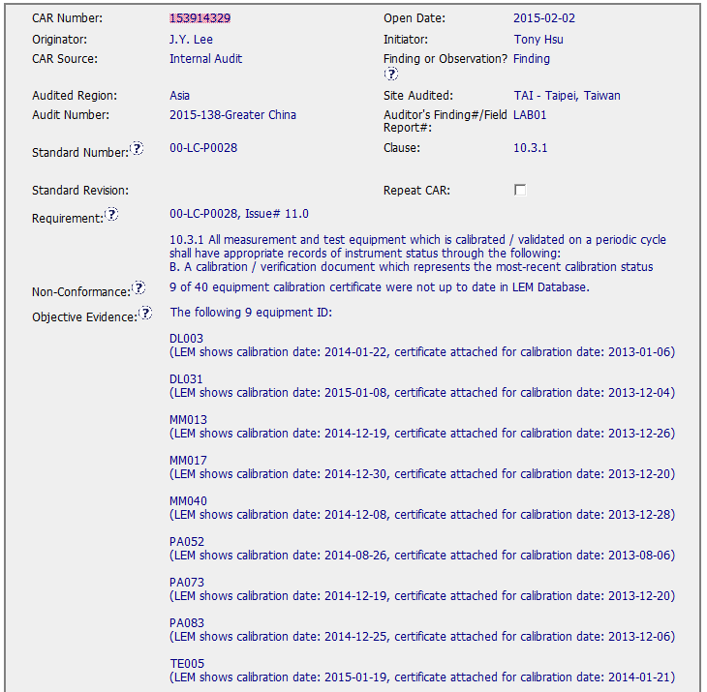
CAR 153914329
The Standard number should reference to ISO 17025 with correct revision date and applicable clause.
Open Discussion: Sample size?

Slide 2
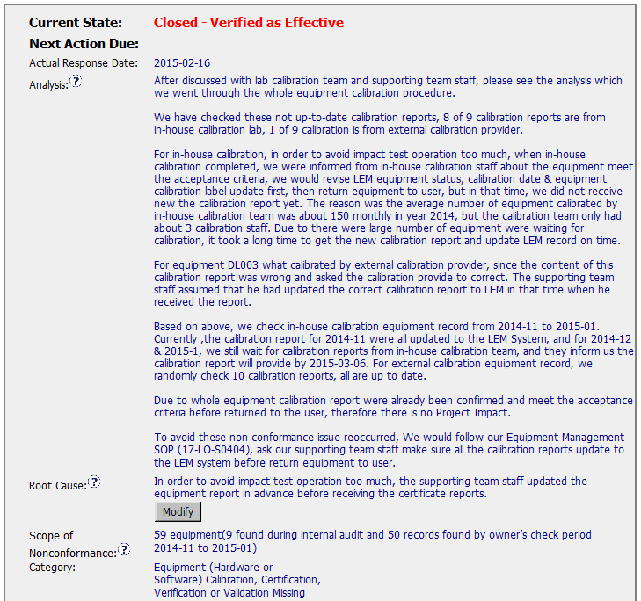
CAR 153914329
Open discussion: names would be included?

Slide 3
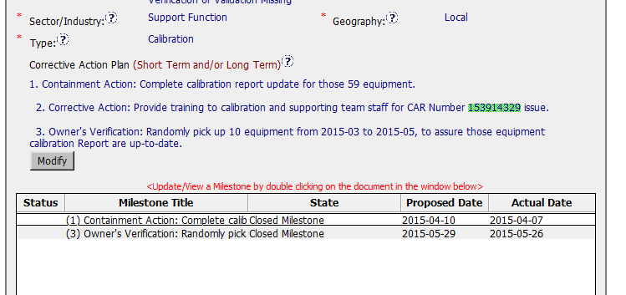
CAR 153914329
Open discussion: a.Corrective action No. 2 was embedded into the first milestone.
b.Corrective action only address the training but not take into account the lack of resources.

Slide 4
CAR 153914329 - CBS
INTEGRITY: Initiative & Decision Making / Analyzing & Problem Solving
Facilitates progression of the CAR through closure: extensions, escalations, reassignments, etc. (+)
Accurately completes the administrative fields within the CAR such as root cause category, process impacted, geography, etc. (-) Standard number was not appropriate
Acts on CARs within the required timeframe (+)
Most appropriate ‘category’, ‘type’, ‘geography’ are selected (+)

Slide 5
CAR 153914329 - CBS
COMPETIVENESS: Customer Focus / Achieve Business Results / Flexibility
Assists customers as they address all aspects of the CAR – analysis, root cause statement, milestone, containment, verification, etc. (-)
Verifies CARs timely (+)
Analysis shows clear path to root cause and scope; stakeholders identified (?)Actual names not included
Root cause statement is succinct, reasonable, complete (+)
Corrective actions fix the objective evidence and other problems found; address entire root cause and scope. (-)
Milestones address containment & owner’s verification; completed per milestone expectations (+)
Verification per requirements (+)
COLLABORATION: Leading & Engaging / Teamwork / Communication
Provides pertinent feedback at appropriate times; shares information and keeps others informed (+)

Slide 6
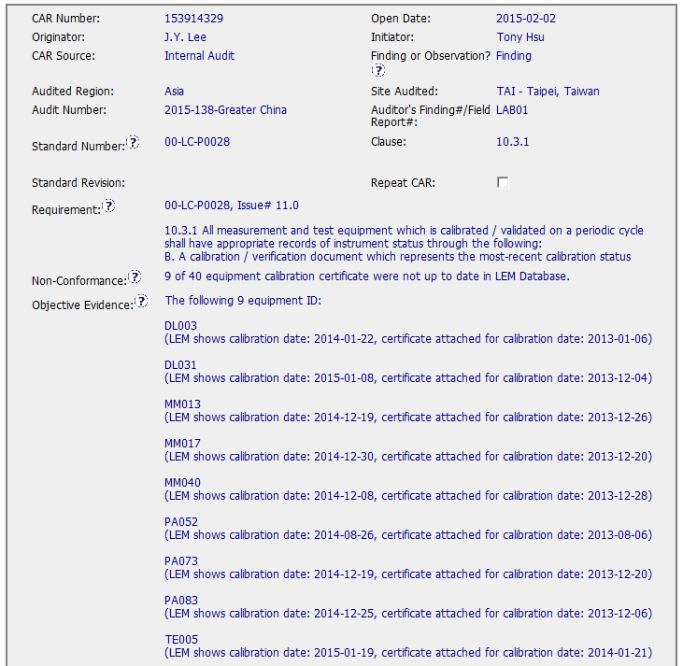
CAR 153914329 - Finding
Audit and Finding #s correlate with audit calendar and report
Clear requirement, nonconformance and objective evidence.
Included total equipment sampled to show recurring and potential systemic issue.

Slide 7
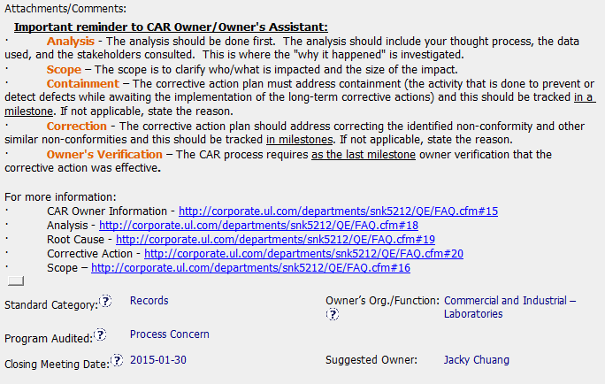
CAR 153914329 - Finding
Good visual reminder of actions, responses needed and help links for owner.

Slide 8
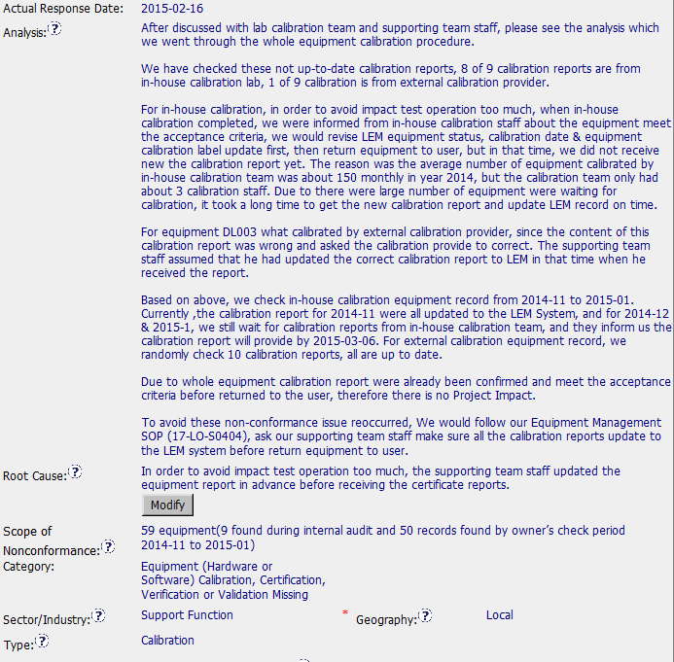
CAR 153914329 - Finding
Stakeholders included.
Checked more equipment to determine scope (how widespread) and length of delay.
Identified no impact to test data.
Corrective action statement in training milestone instead of analysis.
Could ask to dig deeper but RC reaches a point of process breakdown. This is enough analysis such that if process is effectively changed, issue can be prevented.

Slide 9
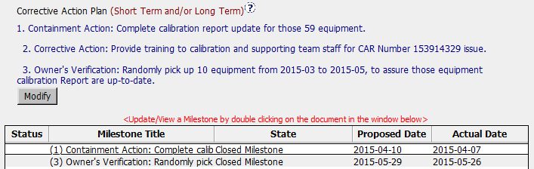
CAR 153914329 - Finding
Appropriate CAP and milestones created.

Slide 10
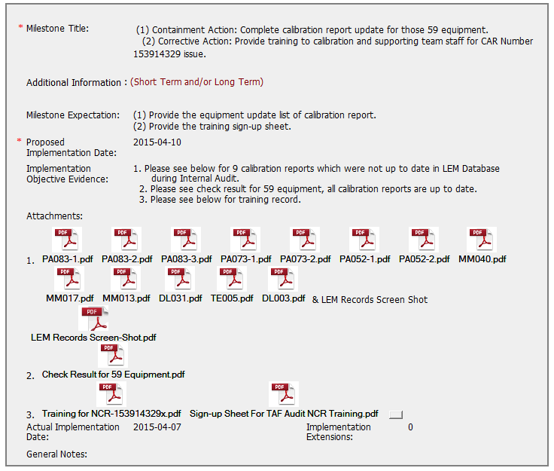
CAR 153914329 - Finding
Milestone completed as expected.
Appropriate expectations and objective evidence.
Calibration certificates attached here are labeled differently from those in LEM. Could add in “General Notes” that they were verified.

Slide 11
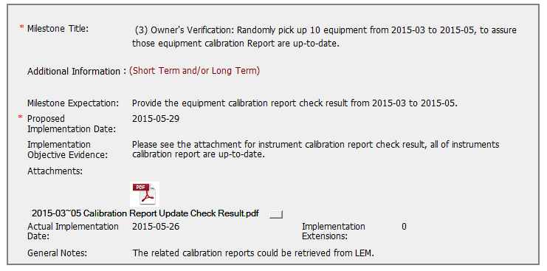
CAR 153914329 - Finding
Milestone completed as expected.
Appropriate expectations and objective evidence.
Suggestion: Sample to assure reproducibility across responsible staff.
Excellent note!

Slide 12
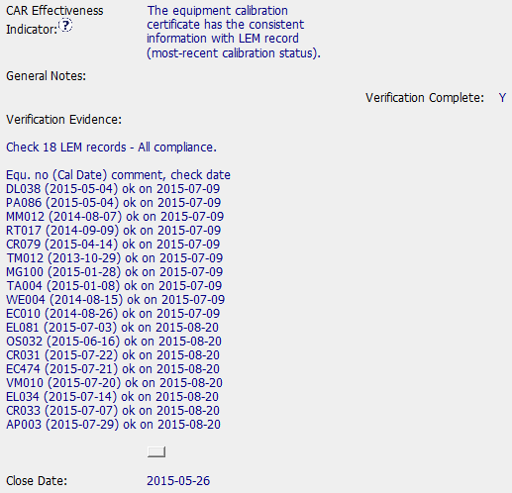
CAR 153914329 - Finding
2 phase verification to span more time.
Evaluated different equipment than that issued in CAR.
Recorded specific evidence.
Closed same day as milestone submission date.

Slide 13
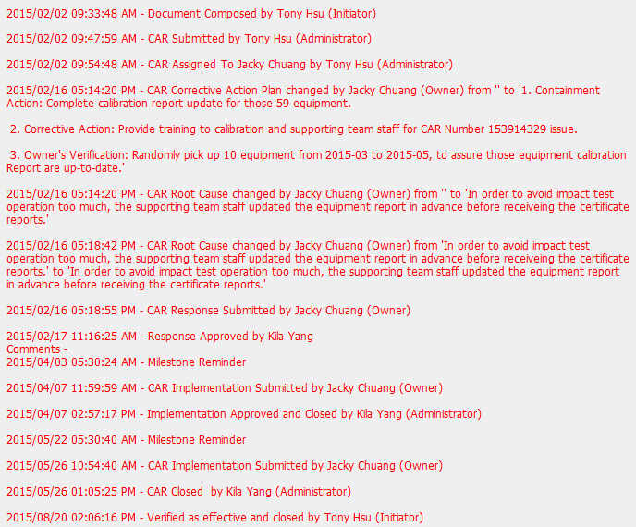
CAR 153914329 - Finding
Smooth progress.
Submissions always earlier than due date.
Evaluation/closes consistently within 1 day!
No extensions!

Slide 14
CAR 153914329 – CBS Check
CBS Requirements | Excellent | Moderate | Need Improve | N/A
INTEGRITY
(C) Extensions are within requirement (<30 days, 3 or less) |  |  |  | X
(T) Most appropriate ‘category’, ‘type’, ‘geography’ are selected | X
(P) Facilitates the handling of disputed CARs |  |  |  | X
(T) Acts on CARs within required timeframe | X
COMPETITIVENESS
(C) Analysis shows clear path to root cause and scope; stakeholders identified |  | X
(C) Root cause statement is succinct, reasonable, complete (Shows ‘N/A’ for observations) |  | X
(C) Corrective actions fix the objective evidence and other problems found; address entire root cause and scope. For observations, they do not go beyond fixing the objective evidence | X
(C) Milestones address containment & owner’s verification; completed per milestone expectations | X
(P) Verification per requirements | X
COLLABORATION
(L Referenced communications are attached as needed | X
(C L) Evidence of communication for overdue/escalated CARs and other pertinent concerns |  |  |  | X
(P) Trains other CAR Champions |  |  |  | X

